Slide 2
Topics
Exercises from Chapters 7, 8 and 9
Working with other kinds of html form fields
Control Structures
Strings
Regular expressions
We’ll talk about all of this in the context doing the problems from lab 3

Slide 3
Exercise 7 - 1
Is the first problem in lab 3. The starting files are in moodle
index.php contains the html form
display_results.php contains comments that tell you what to do. The instructions are in the book as well.
Let’s run the starting files and look at the code for both pages.

Slide 4
Exercise 7 - 1
Html form contains
Textbox – you’re experts with these ☺
Radio button
Check box
Combo box
Text area
Let’s change the method to get. What gets appended to the end of the url for each?
What does the textbook say about each?

Slide 5
Exercise 7 - 1
Use filter_input to get all of the data from the form. Notice that
You can filter for valid email addresses.
You can not validate for password or phone number. That’s ok for right now.
The radio button and check box will return NULL rather than false if the user doesn’t fill anything in.
If you don’t use filter input for the text area, some interesting things happen. Let me demonstrate.

Slide 6
Exercise 8 - 1
Chapter 8 reviews control structures in php
Selection (if and switch)
Repetition (for, while, do while)
Relational operators
Logical operators (and, or, not)

Slide 7
Exercise 8 - 1
Let’s run the starting files and look at the code.
The exercise (page 259) asks you to change the logic for the calculation of the discount and to do it with both an if statement and a switch statement

Slide 8
Exercise 8 - 2
Let’s run the starting files and look at the code.
The most interesting thing about this exercise is the fact that the form has 2 submit buttons. A switch statement is used to determine which button is pressed.
The exercise asks you to (page 260)
Calculate the total and the average
Use different control structures to do the processing.

Slide 9
Exercise 9 – 1 +
Let’s run the starting files and look at the code.
The exercise asks you to use string manipulation functions to do “custom” validation of input.
Do that now.
How could you improve on the validation that the textbook asked for? That’s the next problem in the lab. Add something that’s a little more “robust” than the exercise.
When you’re finished I’m going to introduce you to regular expressions and show you how to use them to do validation. EXTRA CREDIT in the lab.

Slide 10
Regular Expressions
Allow you to “match” a string to a complex pattern, declaratively rather than procedurally as you did in chapter 9.
The first part of chapter 15 in the text talks about regular expressions. This information is included in this set of slides. IT IS NOT ON THE READING QUIZ and is EXTRA CREDIT in the lab.
Regular expression demo (I got this from an old version of the JS book) is included in the starting files. Use it to practice regular expression syntax. The same rules apply in lots of programming languages.

Slide 11
Regular Expressions
Start by looking at SIMPLE predefined expressions in the page.
Look at the expression and get the general idea.
Type in strings and see if you can find strings that will match and things that will not match. Make sure you understand why the string doesn’t match.
Vary the predefined expression slightly and watch what happens with matches after the change.
Progress to slightly more complex expressions and repeat the process.
Try some of your own.

Slide 12
Regular Expressions
There are lots of functions in php that work with regular expressions. The text talks about preg_match.
Let’s look at preg_match on php.net.
Let’s use a regular expression to validate the phone number in 9-1 for extra credit.
And while we’re at it, how would you use separate error messages for each of the pieces of data.

Slide 13
Exercise 7 – 1 +
Now go back to exercise 7 – 1 and make the validation more robust.
Do something different than what the original version asked for. Make a copy of 7 – 1 folder before you do so you don’t accidentally “nuke” that.
Use regular expressions if you’re feeling comfortable. It’s actually easier than doing string manipulation once you get the hang of it.
Use a separate error message for each of the pieces of data that is incorrect too!

Slide 14
Next Time
You’ll get to practice all of this again with several other applications in the next lab.
Begin to skim chapters 10, 11 and 13.
Reading Quiz 4.
Lab 4
Lab 5 will add Ajax calls to several of the problems that you did in previous labs.
Quiz 1

Slide 18
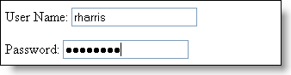

Slide 20
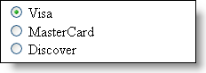

Slide 22
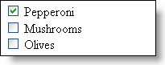

Slide 23
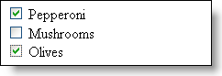

Slide 25
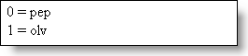

Slide 26
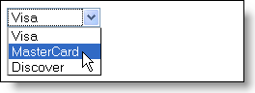

Slide 27
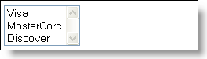

Slide 28
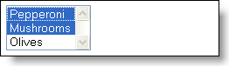

Slide 30
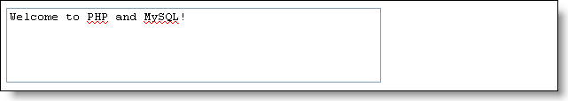

Slide 33
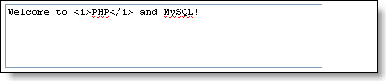

Slide 34
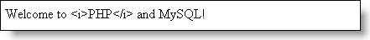

Slide 36
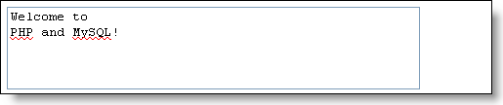
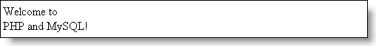

Slide 160
Next Time
You’ll get to practice all of this again with several other applications in the next lab.
Begin to skim chapters 10, 11 and 13.
Reading Quiz 4.
Lab 4
Lab 5 will add Ajax calls to several of the problems that you did in previous labs.
Quiz 1

